Slide 1


Slide 2
Objectives of this Meeting
Knowing/Understanding programs on Students personality development by Tutorrot
Attrition ratio analysis
Long term and Short-term planning
Propose Personality development program
What next?

Slide 3
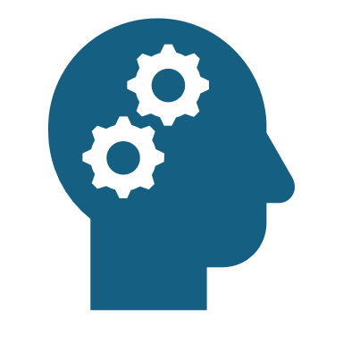
Personality Development Program
Overview:
Our Personality Development Program is specifically designed to help school and college students build the skills, confidence, and emotional resilience needed for success in their personal and academic lives. This holistic program focuses on nurturing essential life skills that go beyond academic knowledge, helping students become well-rounded individuals with strong interpersonal abilities, leadership qualities, and self-awareness.
By Vallabha H Deshpande
Mentor, Coach, Trainer

Slide 4
Program Objectives:
1. Boost Confidence and Self-Esteem: Empower students to believe in themselves, embrace their strengths, and work on areas of improvement.
2. Improve Communication Skills: Enhance verbal and non-verbal communication through interactive activities, ensuring students can express themselves clearly and effectively.
3. Build Emotional Intelligence (EQ): Teach students to understand and manage their emotions, develop empathy, and foster healthy relationships.
4. Foster Leadership and Teamwork: Encourage leadership qualities and the ability to work collaboratively in group settings, helping students become proactive and responsible.
5. Develop Time Management and Goalsetting skills: Provide strategies for effective time management and goal setting to help students balance academics, extracurriculars, and personal interests.
6. Enhance Decision-Making and Problem-Solving Skills: Equip students with the tools to make informed decisions, think critically, and solve problems effectively.
7. Create a Positive Mindset and Attitude: Promote optimism, resilience, and a growth mindset, ensuring students can cope with challenges and maintain a positive outlook on life.
8. Career and Professional Readiness: Offer guidance on career planning, interview preparation, and professional etiquette to prepare students for the future.

Slide 5
Vital life skills that are often overlooked in traditional education include:
1. Emotional Intelligence (EQ):
While academic intelligence (IQ) is often prioritized, the ability to understand, manage, and express emotions effectively is equally crucial. EQ helps with empathy, emotional regulation, and relationship management.

Slide 6
Vital life skills that are often overlooked in traditional education include:
2. Critical Thinking and Problem-Solving:
Many students are not taught how to analyze situations, identify potential solutions, or make well-reasoned decisions. These skills are essential for tackling real-life challenges and adapting to unexpected situations.

Slide 7
Vital life skills that are often overlooked in traditional education include:
3. Financial Literacy:
Basic financial skills, such as budgeting, saving, managing debt, and understanding credit, are rarely covered in-depth. Financial literacy is fundamental for responsible and independent adulthood.

Slide 8
Vital life skills that are often overlooked in traditional education include:
4. Time Management and Organization:
While assignments and deadlines are a part of school, the actual skills to prioritize tasks, manage time effectively, and organize daily schedules often go untaught, leaving many students unprepared for independent life.

Slide 9
Vital life skills that are often overlooked in traditional education include:
5. Communication Skills:
Beyond basic reading and writing, interpersonal communication skills, such as active listening, public speaking, assertiveness, and conflict resolution, are essential but often neglected.

Slide 10
Vital life skills that are often overlooked in traditional education include:
6. Self-Discipline and Goal Setting:
Schools emphasize achievement but may not provide tools for setting personal goals, staying motivated, or cultivating self-discipline to accomplish them over time.

Slide 11
Vital life skills that are often overlooked in traditional education include:
7. Adaptability and Resilience:
The ability to handle failure, manage stress, and bounce back from setbacks is crucial for personal and professional success. This is often not a core focus in academic environments

Slide 12
Vital life skills that are often overlooked in traditional education include:
8. Mindfulness and Stress Management:
Techniques for managing stress, mindfulness, and mental well-being are rarely taught, despite their importance in maintaining emotional health, focus, and productivity.

Slide 13
Vital life skills that are often overlooked in traditional education include:
9. Basic Home and Health Management:
Practical skills like cooking, basic first aid, and household management are necessary for self-sufficiency and overall well-being.

Slide 14
Vital life skills that are often overlooked in traditional education include:
10. Cultural Awareness and Diversity:
While students may learn about history and global events, practical skills for navigating diverse social environments with cultural sensitivity and understanding are often missing.

Slide 15
Vital life skills that are often overlooked in traditional education include:
11. Digital Literacy and Responsible Technology Use:
In a tech-driven world, digital literacy (beyond basic computer skills) and responsible internet use, including online safety and media literacy, are essential yet frequently overlooked.

Slide 16
Vital life skills that are often overlooked in traditional education include:
12. Environmental Responsibility:
Sustainable practices, resource conservation, and awareness of environmental issues are crucial life skills for the future but may be minimally integrated into standard curriculums.

Slide 17
Program Structure:
The program is divided into modules that cover different aspects of personality development. Each module is designed to be interactive, with a mix of lectures, group discussions, role-plays, and hands-on activities.

Slide 18
1. Self-Awareness and Personal Growth
Understanding oneself
Recognizing strengths and weaknesses
Building self-confidence

Slide 19
2. Effective Communication and Public Speaking
Art of speaking with confidence
Listening skills
Non-verbal communication

Slide 20
3. Emotional Intelligence and Stress Management
Understanding emotions
Managing stress and anxiety
Building resilience

Slide 21
4. Leadership and Teamwork .
Leadership styles and qualities
Working effectively in teams
Conflict resolution

Slide 22
5. Time Management and Study Skills
Prioritizing tasks
Managing distractions
Study techniques for academic success

Slide 23
6. Goal Setting and Motivation
Setting SMART goals
Staying motivated
Overcoming obstacles

Slide 24

Duration:
The program can be customized based on the needs of the institution. It can range from a one-day intensive workshop to a month-long course with regular sessions.
Target Audience:
The Personality Development Program is designed for students from middle school, high school, and college. The content and activities are tailored to meet the developmental needs of each age group.

Slide 25

Outcomes:
By the end of the program, students will:
- Exhibit increased self-confidence and self-awareness.
- Communicate more effectively with peers, teachers, and family.
- Demonstrate emotional resilience and stress management skills.
- Show leadership and teamwork abilities in various settings.
- Be better prepared for future academic and career challenges.

Slide 26

Methodology:
Workshops and Interactive Sessions: Engaging and dynamic workshops that encourage participation and experiential learning.
Role-Plays and Group Activities: Hands-on activities that allow students to practice new skills in a supportive environment.
Personalized Feedback: Regular assessments and feedback to help students track their progress and make continuous improvements.

Slide 27

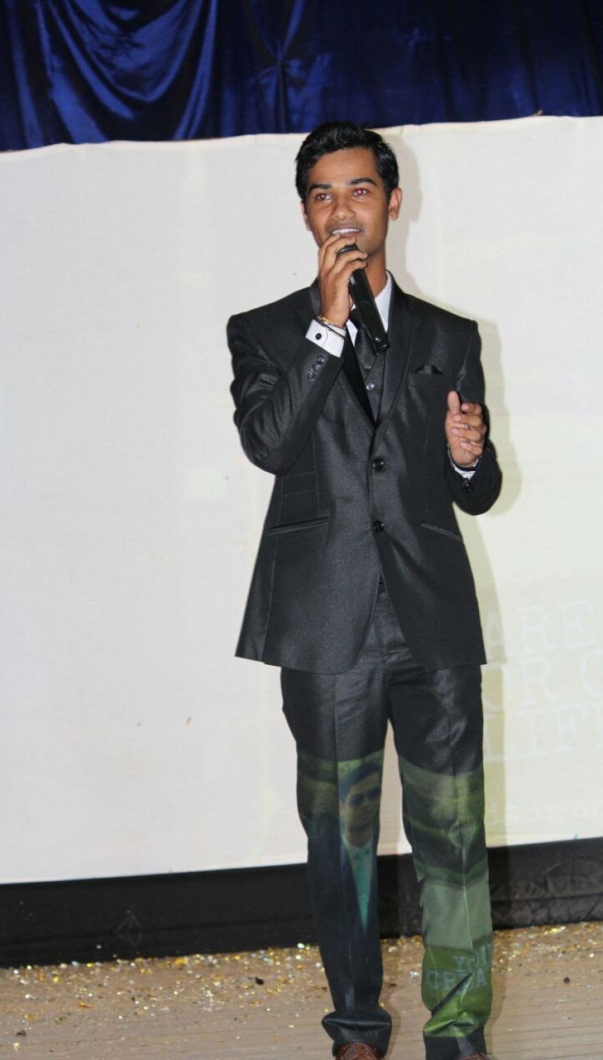
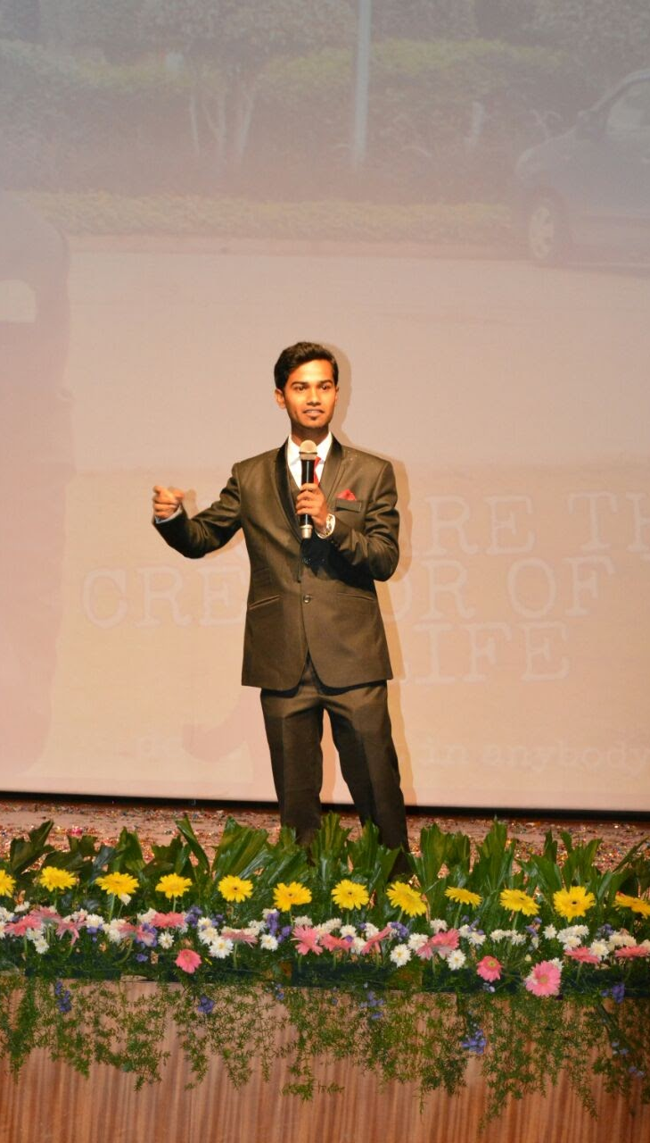
About Mentor
An inspiring professional, dedicated to guiding students on their journey toward self-awareness, confidence, and holistic growth. I wish to play a pivotal role in shaping young minds to be resilient, emotionally intelligent, and adaptable, equipping them with essential life skills that extend far beyond the classroom. Their focus lies in nurturing each individual’s potential, fostering an inclusive learning environment, and building the foundation for personal and professional success.

Slide 28
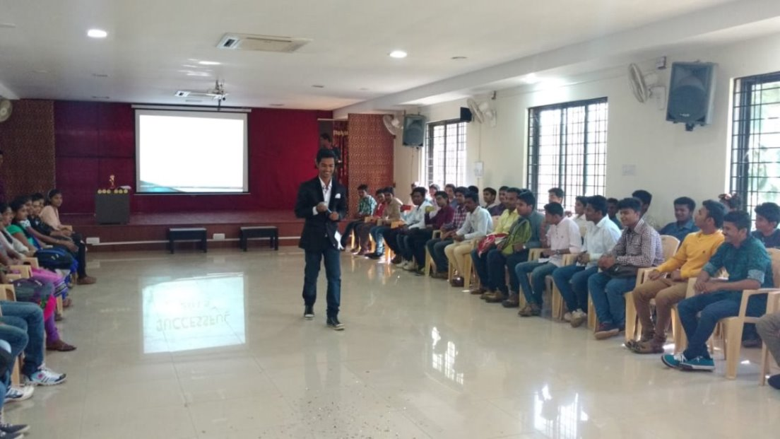
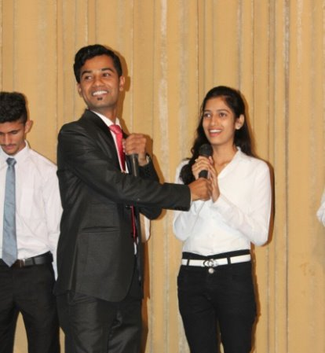
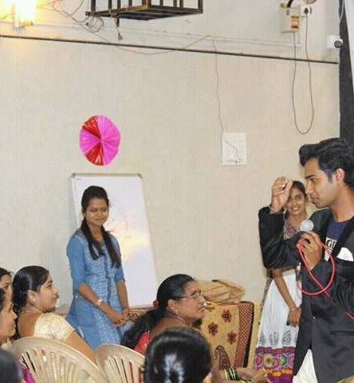
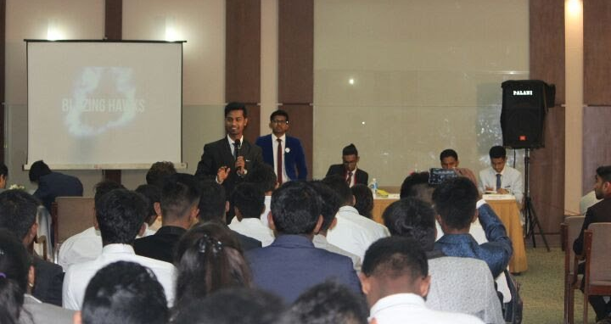
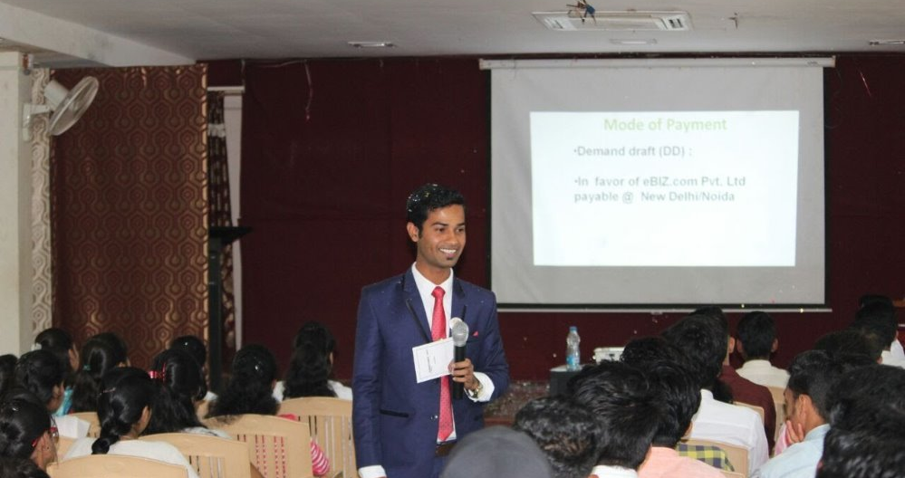
Fun Celebration
Public speaking
Parents- Students collaboration
Mentorship
Training and coaching
Our Programs

Slide 29

Conclusion:
This Personality Development Program aims to equip students with the vital life skills that are often overlooked in traditional education. Through this program, students will be better prepared to face the challenges of life, make meaningful contributions to society, and achieve their full potential.

